Slide 1
Code Check
Team members:
2001148 Prathik
2001126 Muthuram
2001133 Nimal Raj
Team Mentor:
Mrs. Indira Priyadharshini AP/CSE

Slide 2
AGENDA:-
Introduction to domain
Literature Survey
Problem Statement
Hardware Software requirements
Modules and descriptions
Implementations
References

Slide 3
Introduction to Domain:-
Web development is the work involved in developing a website for the Internet (World Wide Web). Web development can range from developing a simple single static page of plain text to complex web applications, electronic businesses, and social network services.
It includes aspects such as web design, web publishing, web programming, and database management . The websites can created to provide services to different sectors in more efficient way. Nowadays almost all the startups are creating websites to promote themselves in larger scale.

Slide 4
LITERATURE SURVEY
Ulas Gulec, Murat Yilmaz, Veysi Isler,”Creation of Integrated Development Environment”, Journal of Universal Computer Science, vol. 23, no. 8 (2017), 725-754 submitted: 4/5/17, accepted: 26/8/17, appeared: 28/8/17 © J.UCS
From the above literature survey we have learned about the how to create a integrated coding platform to run and compile different languages . Also they have integrated error detection and compilation detection.

Slide 5
LITERATURE SURVEY
Renee Garett, MS, LCSW,1 Jason Chiu, MS, Ly Zhang, and Sean D. Young, PhD, MS,” Website Design and User Engagement”,Online J Commun Media Technol. 2016 Jul; 6(3): 1–14.
We have got an idea about the navigation, graphical representation, organization, content utility, purpose, simplicity, and readability.

Slide 6
Problem Statement:-
Nowadays there are many resources in online platform but for quality and efficient only paid versions are available.
Even tough high paid versions, they do not have doubt clearance space which is very much important at learning curve.
Students do just finish courses for the sake of certificates.
Problems regarding projects references ,published papers and collecting ideas for a particular problem statement.
Lack of motivation of students in implementation.

Slide 7
Software Requirements:-
ReactJs
NodeJs
MongoDB
GNU Compiler

Slide 8
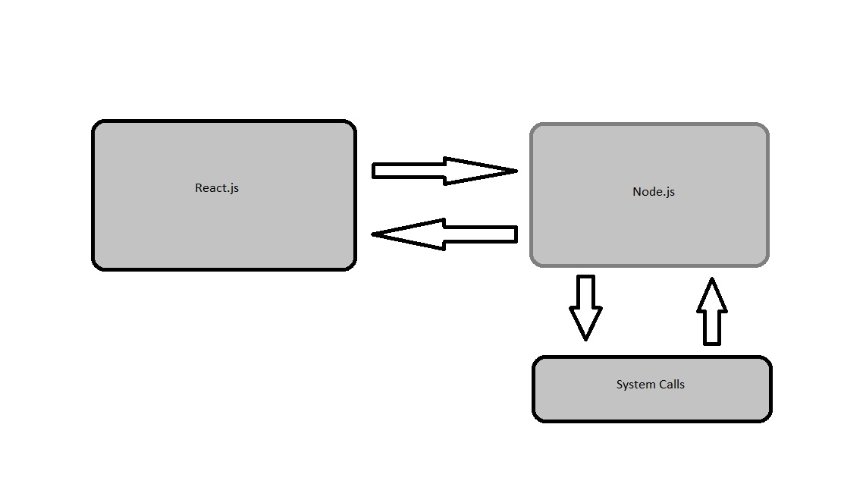
Process:-
Language
code

Slide 9
Module 1:-
In module 1 we have designed a UI for the online compiler and we have implemented using the ReactJs.
The UI consists of selecting the language and type area to code in particular language.
It also consists of submit button to compile and run the program.
The output area consists of status of the output of the program, Job Id,time details and execution time.

Slide 10
Module 2:-
We have used NodeJs as the back end. NodeJs has one the functionality call child process which is used to execute system shell commands.
So we use exec() function form child process to compile and execute programs.
We used expressJs for posting the request form the client side to the server side . The request consists of
-Language
-Code

Slide 11
cont
Through axios we communicate form the client side to the server side and pass the request to the express.Js
ExpressJs listens to the nodeJs.
We used postman API to check the communication between the client and the server side.
NodeJs back-end communicates with the system shell and executes the program.
Since we have locally hosted we might get a problem while communicating between the client and server ports.

Slide 12
cont
Since we have not hosted the application we use functionality called ls which is used to create files and folders in the local system.
We used MomentJs to get the time details and execution time of the program.

Slide 13
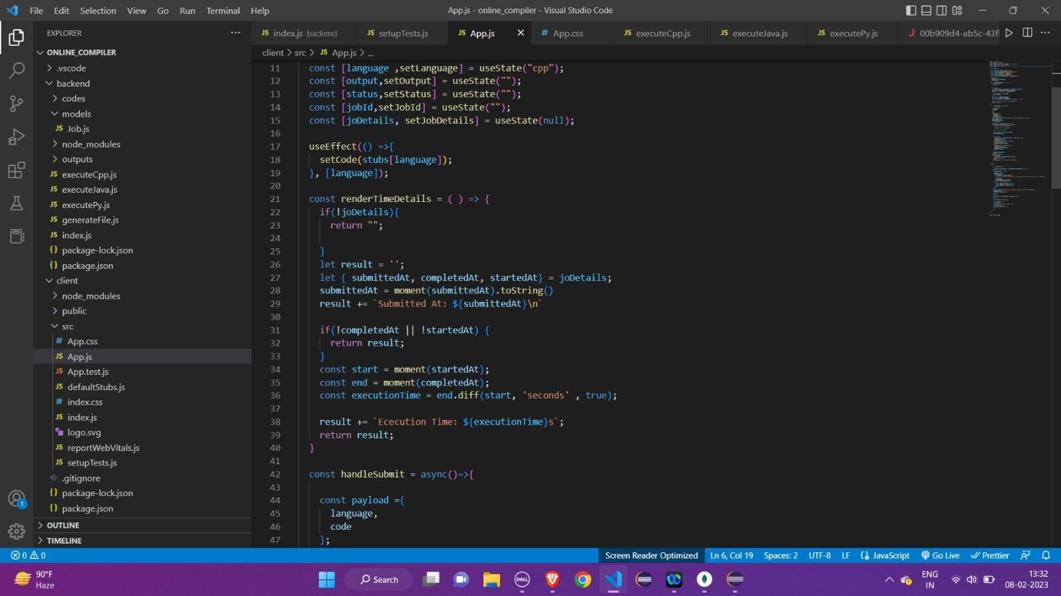
Implementation

Slide 14
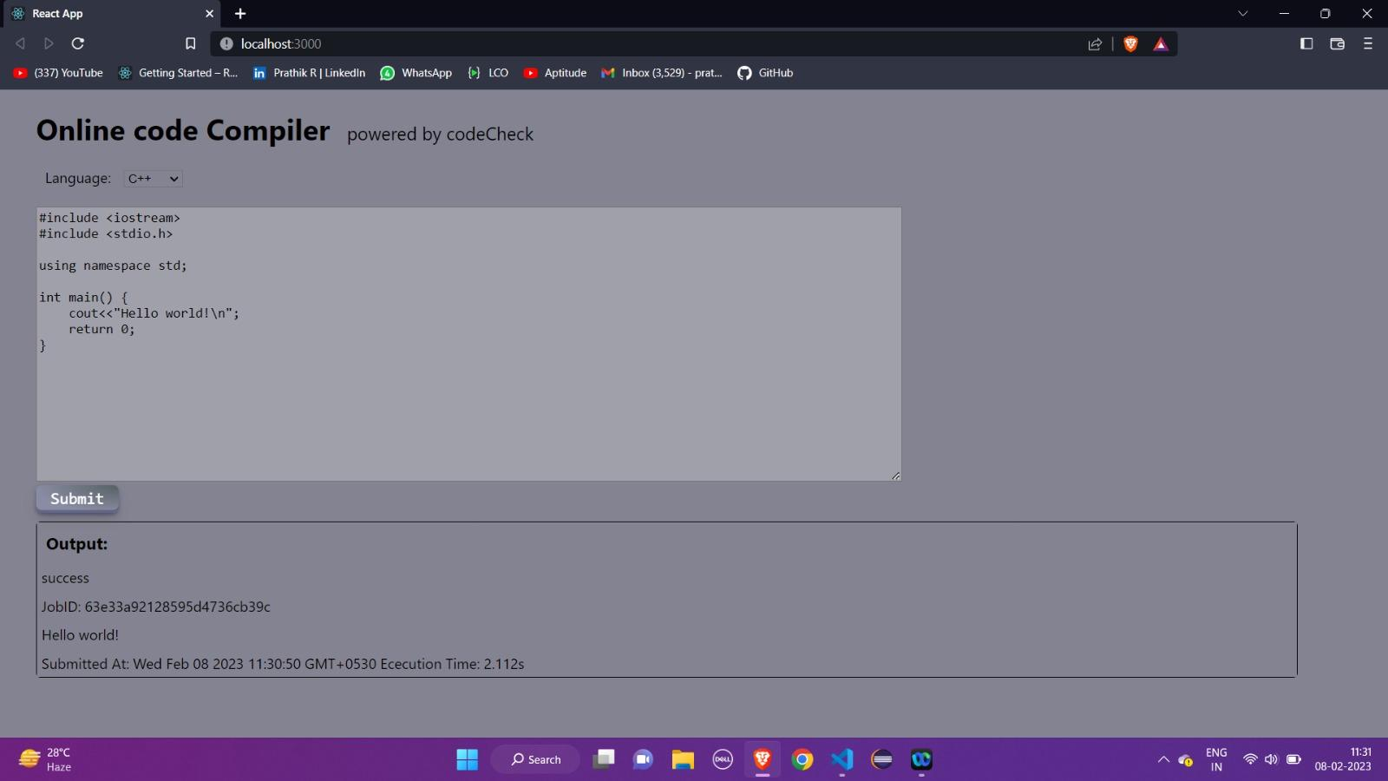
Implementation

Slide 15
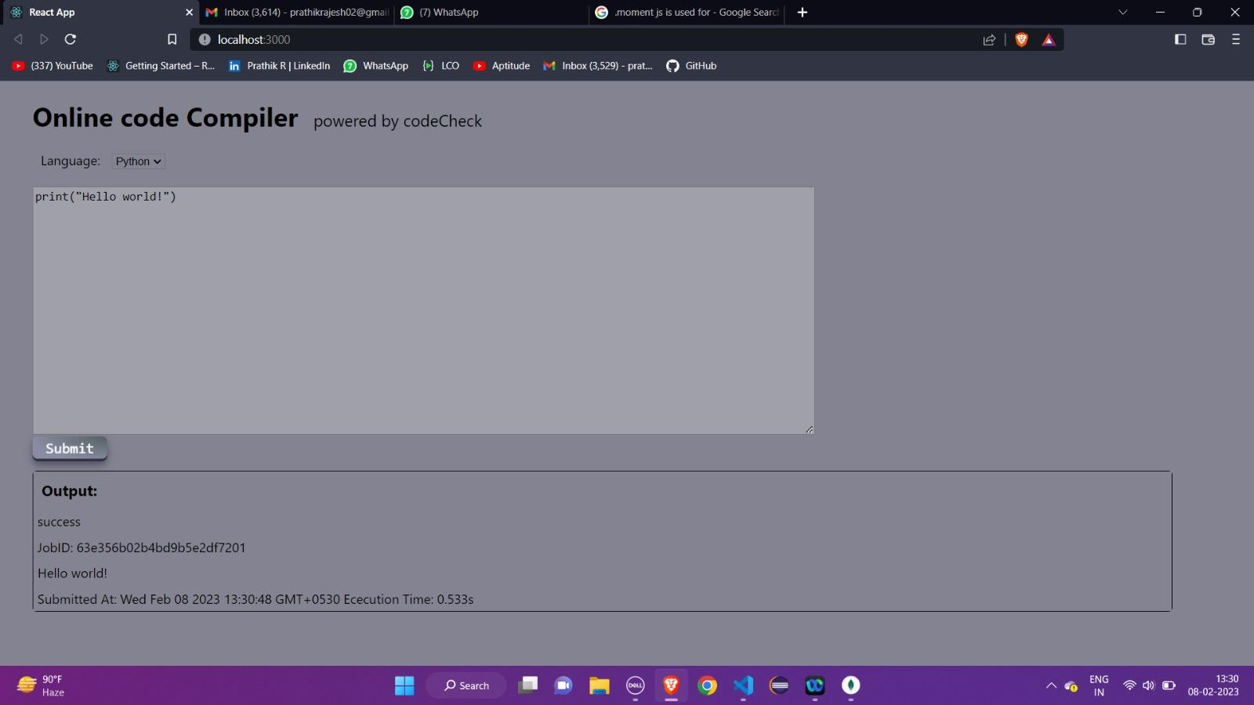
Implementation

Slide 16
Module 3:
In this module we have developed a front end web design for user interface using ReactJs.
We have developed a home page, login page and IDE using ReactJs.
We have used the bootstrap elements to all new components in this website.
We have used css animation for the background the front end web page.

Slide 17
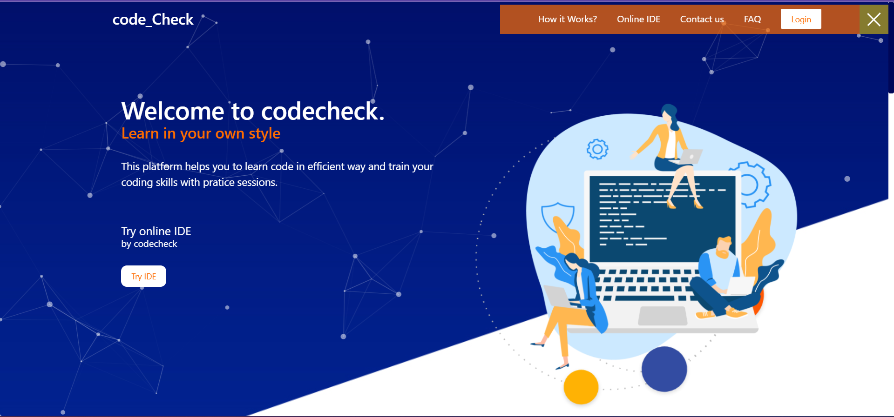

Slide 18
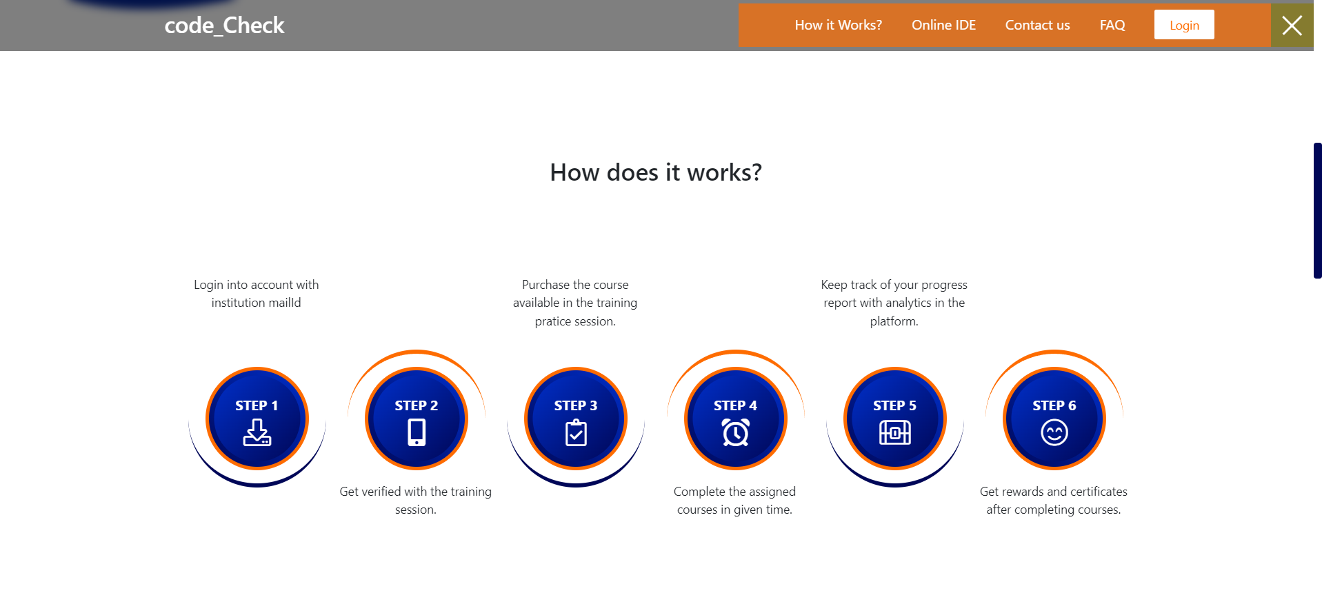

Slide 19
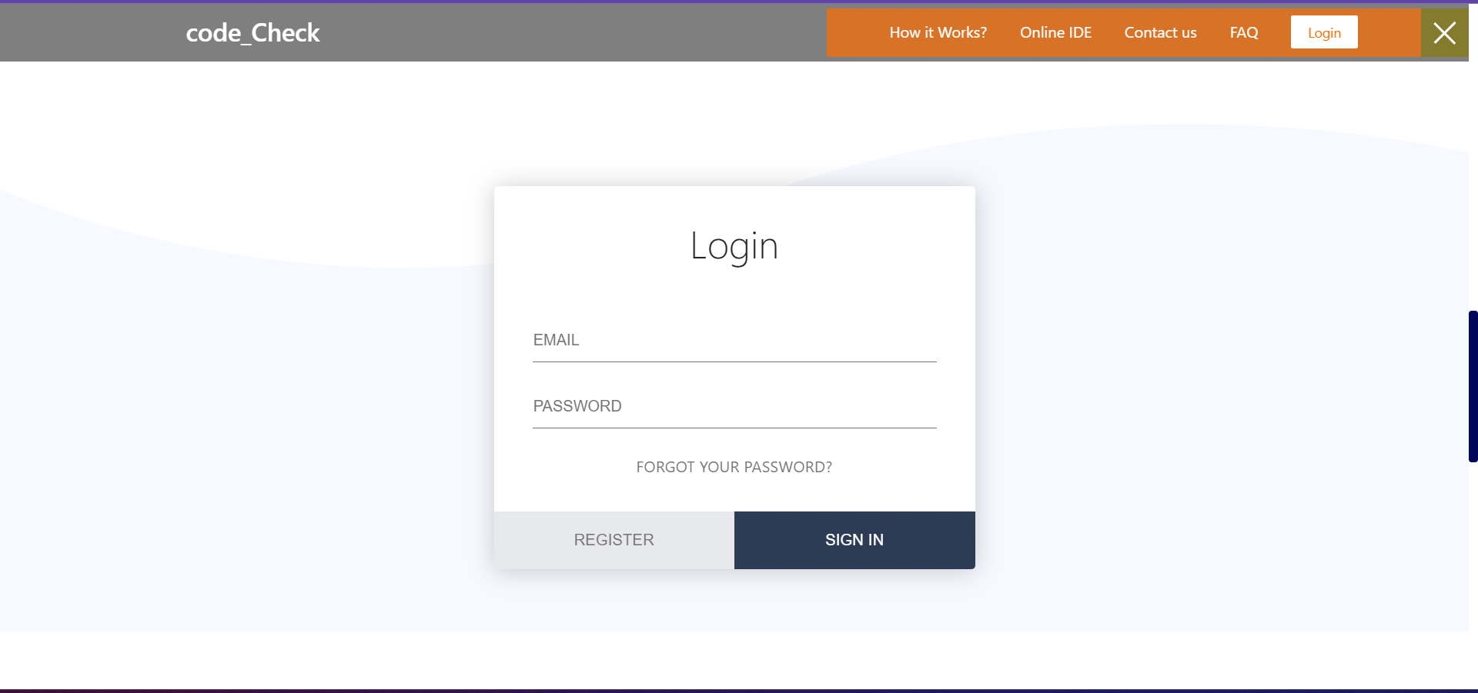

Slide 20
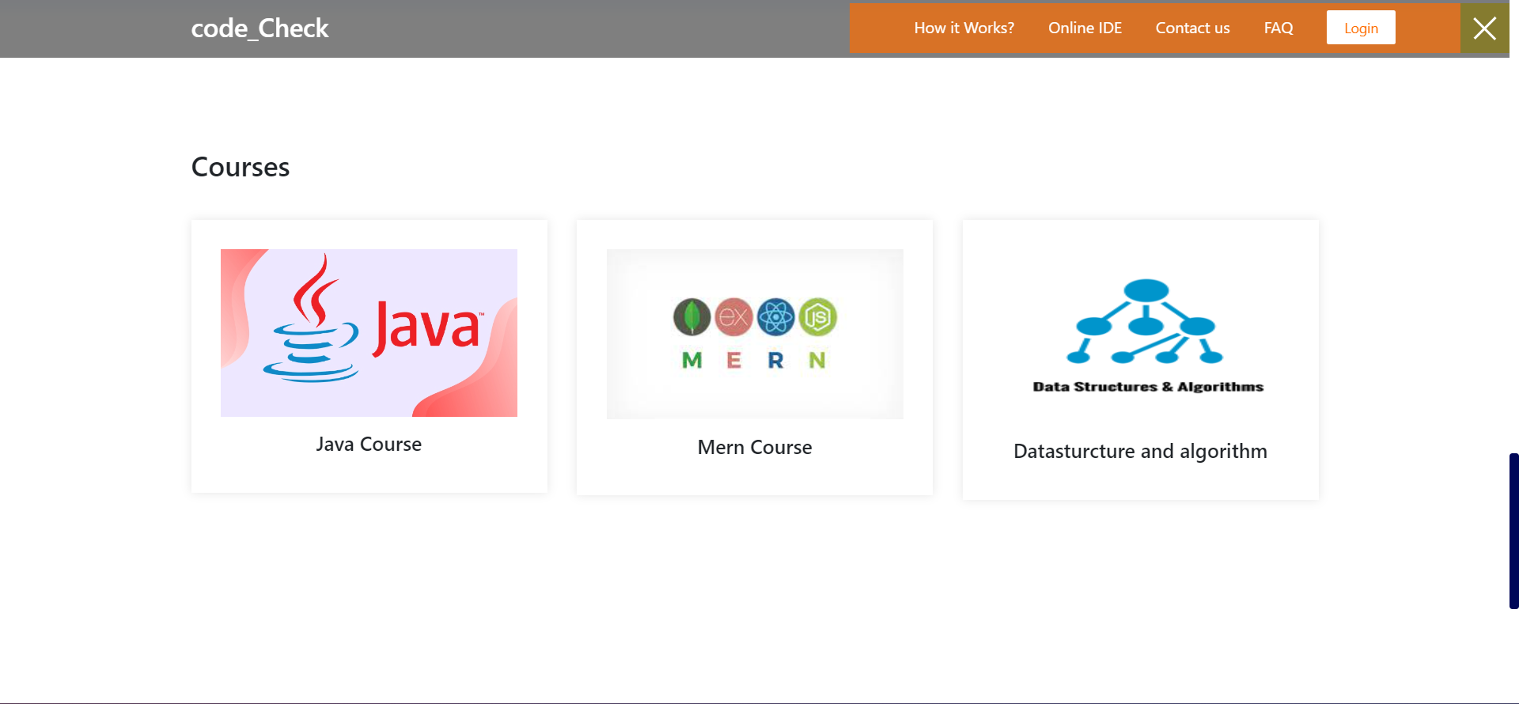

Slide 21
References:-
International Standardization Organization. ISO 2941-11:1998 Ergonomic requirements for office work with visual display terminals (VDTs) -- Part 11: Guidance on usability: International Standardization Organization (ISO) 1998.
Internet Use Over Time. 2014 Jan 2; Retrieved February 15, 2015, from http://www.pewinternet.org/data-trend/internet-use/internet-use-over-time/
Internet User Demographics. 2013 Nov 14; Retrieved February 11, 2015, from http://www.pewinternet.org/data-trend/internet-use/latest-stats/
Nielsen Jakob. Usability 101: introduction to Usability. 2012 Retrieved 2/11, 2015, from http://www.nngroup.com/articles/usability-101-introduction-to-usability/

Slide 22
Thank You

